Slide 1
FRXSH

Slide 2

Back-End Project
Team Details:
Group No. 2
Adish Garg ,2310992090
Harshit Batra ,2310992094
Kavish Khanna ,2310992118
Supervised by: Mr.Vikas Patel
Chitkara University Institute of Engineering and
Technology, Chitkara University, Punjab

Slide 3
Table of Contents
Introduction
Frontend
Backend
Output
Integration & Workflow
Challenges & Solutions
Demonstration
Conclusion

Slide 4
Introduction
Objective: Demonstrating a form to collect user data and a backend API for saving and retrieving the data.
Tools Used:
HTML, CSS, JavaScript (Frontend)
Node.js, and File System (Backend)

Slide 5
Frontend - User Data Form
Features:
Collects user details: Name, Email,D.O.B, Address
User-friendly design with subtle styling
Validations for inputs

Slide 6
Backend - API Overview
Technologies Used:
Node.js
File System (for storing user data locally)
Endpoints:
POST /users: Saves user data to a JSON file
GET /users: Retrieves all saved user data

Slide 7
Backend-Code Highlights
File Handling:
Check and create the users.json file if not present.
POST Endpoint:
Parses and saves incoming user data.
GET Endpoint:
Reads and sends the stored user data.
Error Handling:
Catches and logs errors for both endpoints.

Slide 8
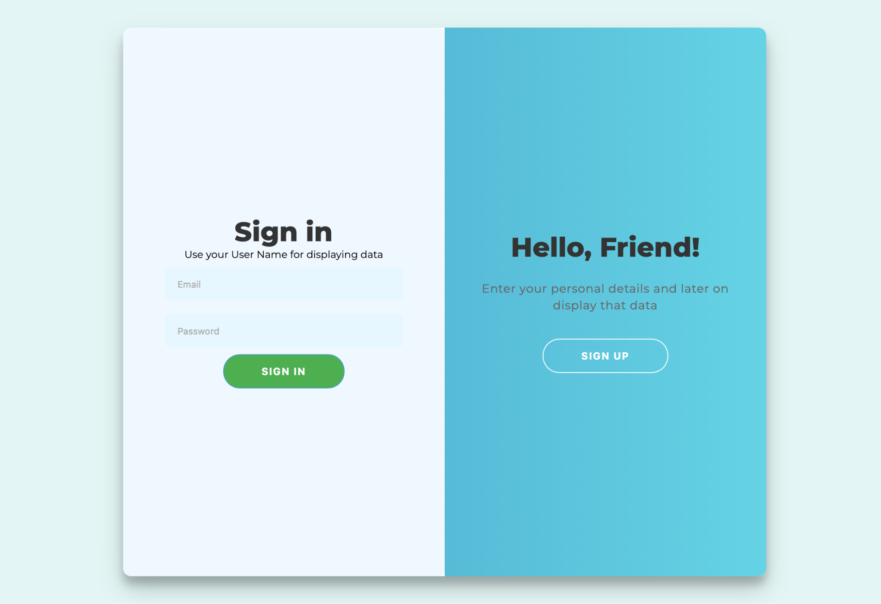
Project Overview

Slide 9
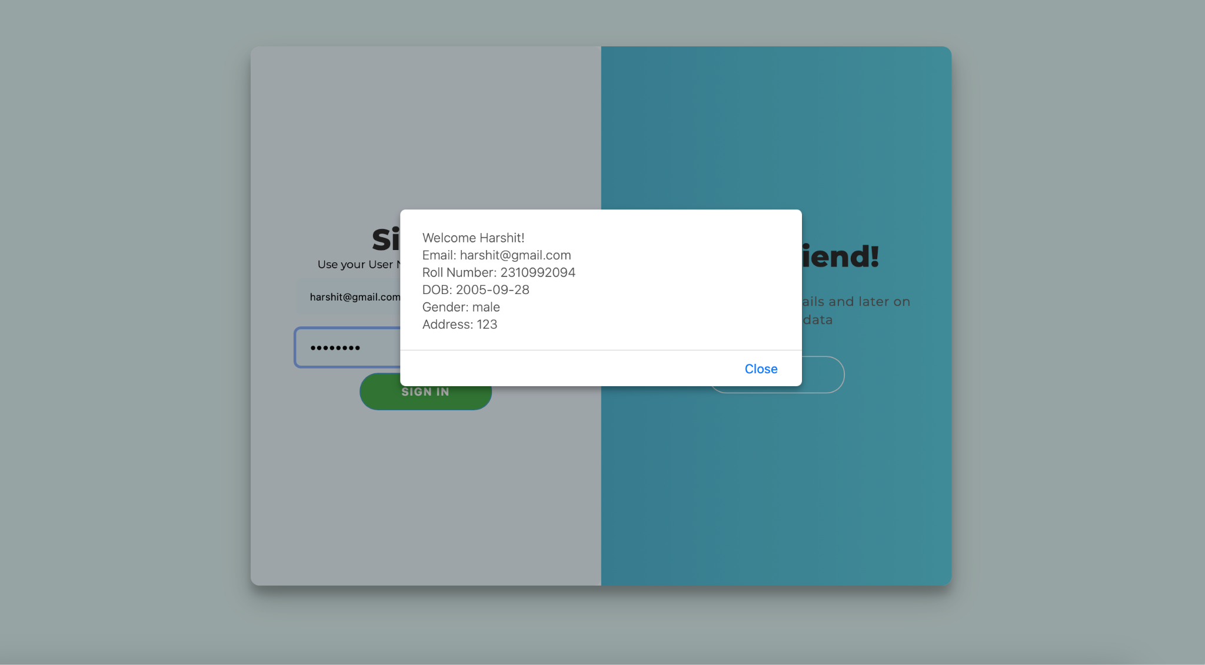

Slide 10
Integration and Workflow
Step 1: User submits the form on the frontend.
Step 2: Data sent via POST request to /users endpoint.
Step 3: Backend stores the data in users.json.
Step 4: Use GET request to retrieve and display saved user data.

Slide 11
Challenges and Solutions
Challenge: Handling file operations efficiently.
Solution: Ensure proper error handling and file checks.
Challenge: Managing seamless communication between frontend and backend
Solution: Use clear API contracts and consistent JSON formatting.

Slide 12
Demonstration
Live Demo:
Submit data through the form.
Verify data storage in users.json.
Retrieve and display stored data via the GET endpoint.

Slide 13
Conclusion
Summary:
Implemented a simple yet functional user data collection system.
Highlighted the seamless interaction between frontend and backend
.
Next Steps: Explore database integration and enhanced features.

Slide 14


